Slide 1
ENSE 470, Milestone 4
ByteThis Software
Taylor Petrychyn, Alwin Baby, and Konstantin Kharitonov
February 28, 2018

Slide 2
Database snapshot
Split into three separate tables
  Software Table, Approver Table and Software Approver ID table
  Each software and approver has id, then id’s are match together
  Using PostgreSQL
Experience in cleansing the data
  Used HeidiSql software to create table. Easy to sort and delete.
  Using Notepad++ to find and replace was helpful.
  Combining the tables was challenging

Slide 3
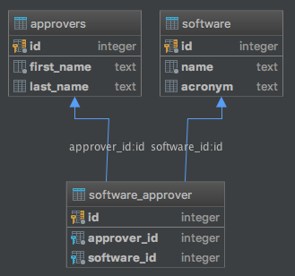
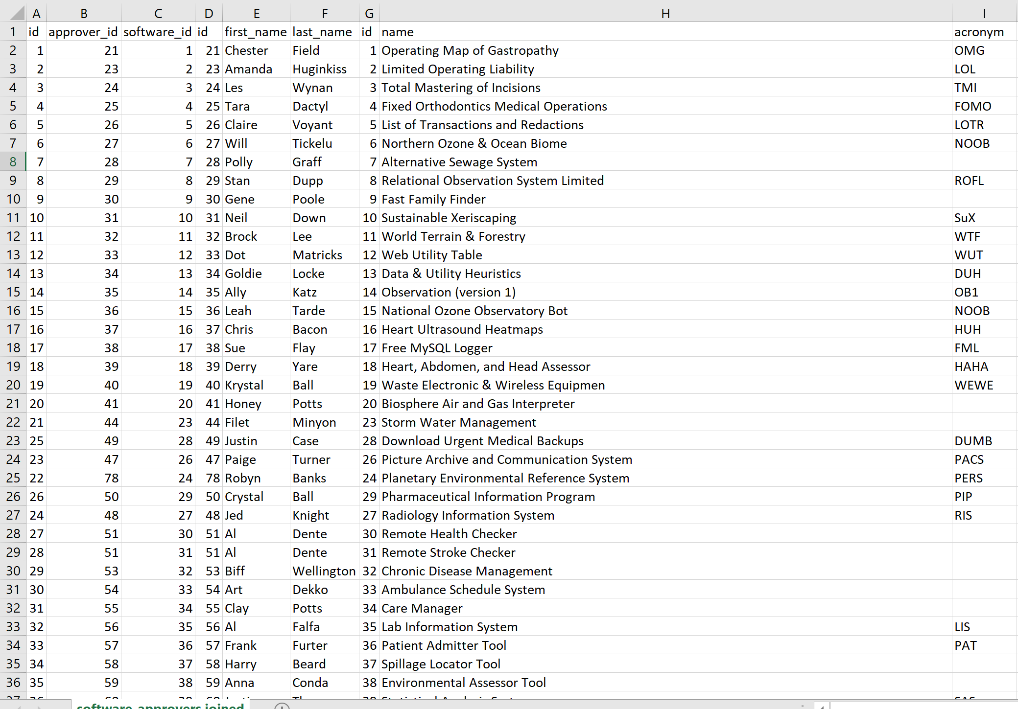
Database Example

Slide 4
MVP Release
User
  Login, Logout functions
  Create, View and Modify applications
Approver
  Search, List and Categorize Requests
  Approve Tickets
Analyst
  List and Approve Tickets
  Add and List Users, Create Approvers

Slide 5
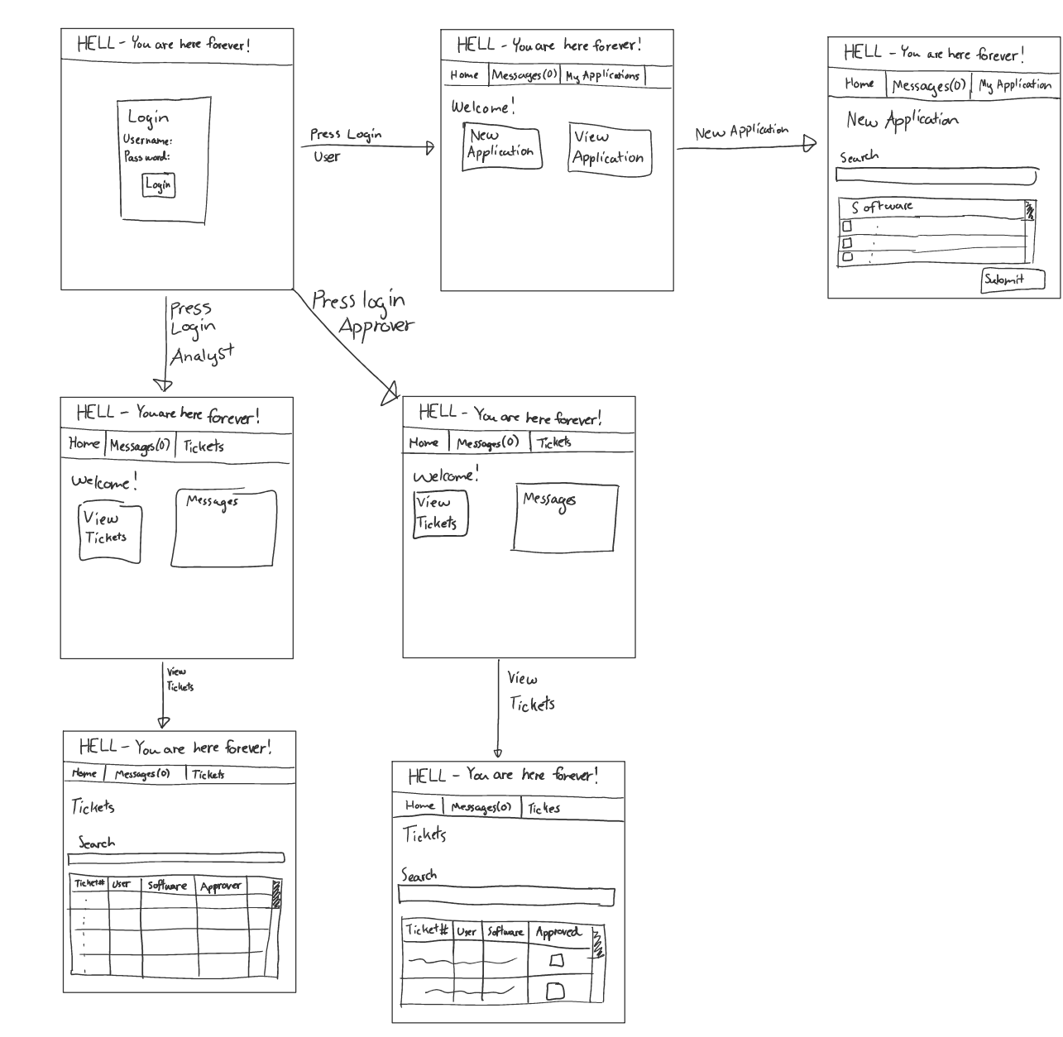
Lo-fidelity prototype snapshots

Slide 6
Changes & Misc.
Planning on using Heroku to build our app
  Node.js over PHP
  Allows for app management client-side

Slide 7
Group reflection
How did you feel about this milestone? What did you like about it? What did you dislike?
  Tricky but a fresh new experience
What did you learn about yourself as you collaborated and worked through this milestone?
  Drawing needs work, SQL is fun
How will you use what you have learned going forward?
  SQL work will help during implementation
What “stuff & things” related to this milestone would you want help with?
  Mapping out low and high fidelity interfaces

